Slide 1
MVC Pattern
Model – View - Controller

Slide 2
Model
Models represent knowledge. A model could be a single object (rather uninteresting), or it could be some structure of objects.
There should be a one-to-one correspondence between the model and its parts on the one hand, and the represented world as perceived by the owner of the model on the other hand.

Slide 3
View
A view is a (visual) representation of its model. It would ordinarily highlight certain attributes of the model and suppress others. It is thus acting as a presentation filter.
A view is attached to its model (or model part) and gets the data necessary for the presentation from the model by asking questions. It may also update the model by sending appropriate messages. All these questions and messages have to be in the terminology of the model, the view will therefore have to know the semantics of the attributes of the model it represents.

Slide 4
Controller
A controller is the link between a user and the system. It provides the user with input by arranging for relevant views to present themselves in appropriate places on the screen.
It provides means for user output by presenting the user with menus or other means of giving commands and data. The controller receives such user output, translates it into the appropriate messages and pass these messages on to one or more of the views.

Slide 5
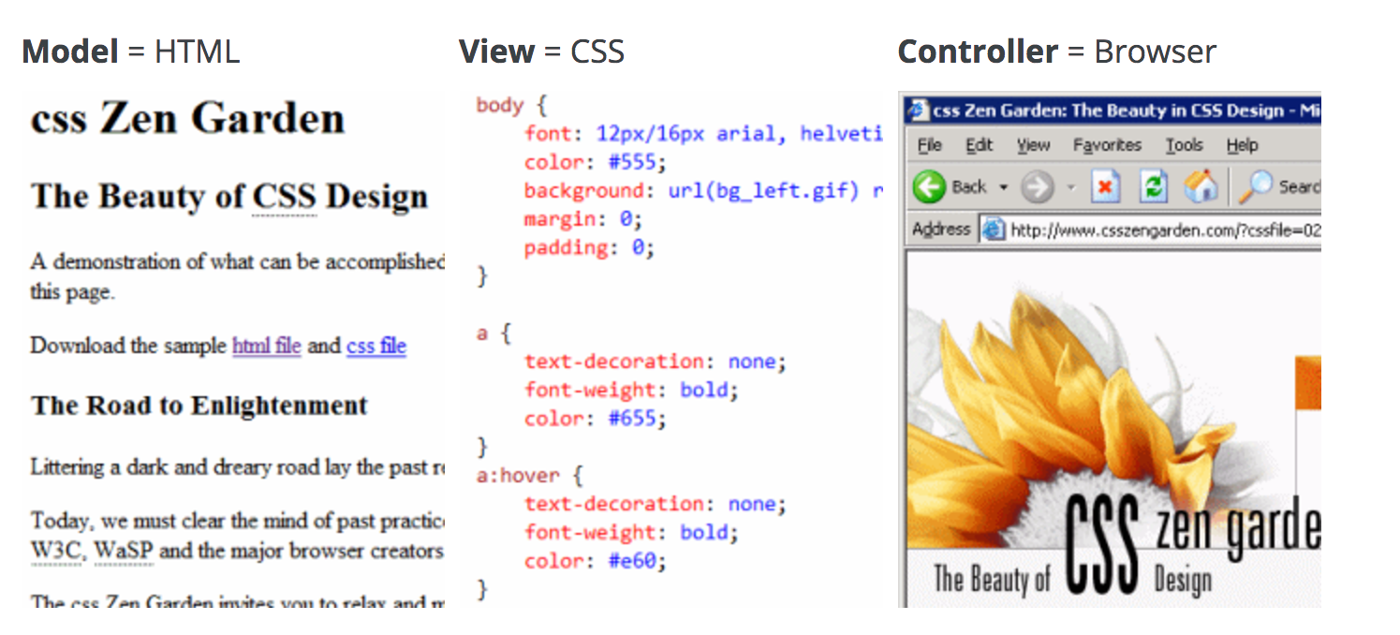
Example

Slide 6
MVC model is very popular
most popular web programming frameworks also encapsulate MVC principles: Django, Ruby on Rails, CakePHP, Struts, and so forth.

Slide 7
Model
The classes which are used to store and manipulate state, typically in a database of some kind.
View
The user interface bits (in this case, HTML) necessary to render the model to the user.
Controller
The brains of the application. The controller decides what the user's input was, how the model needs to change as a result of that input, and which resulting view should be used.

Slide 8
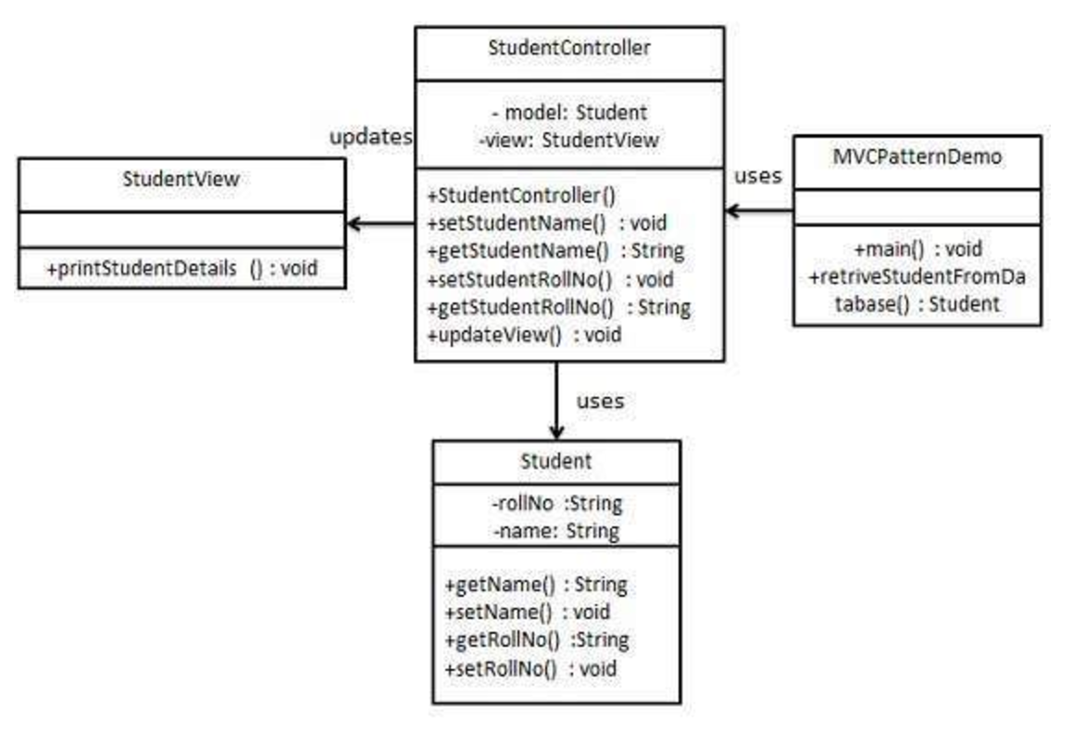

Slide 9
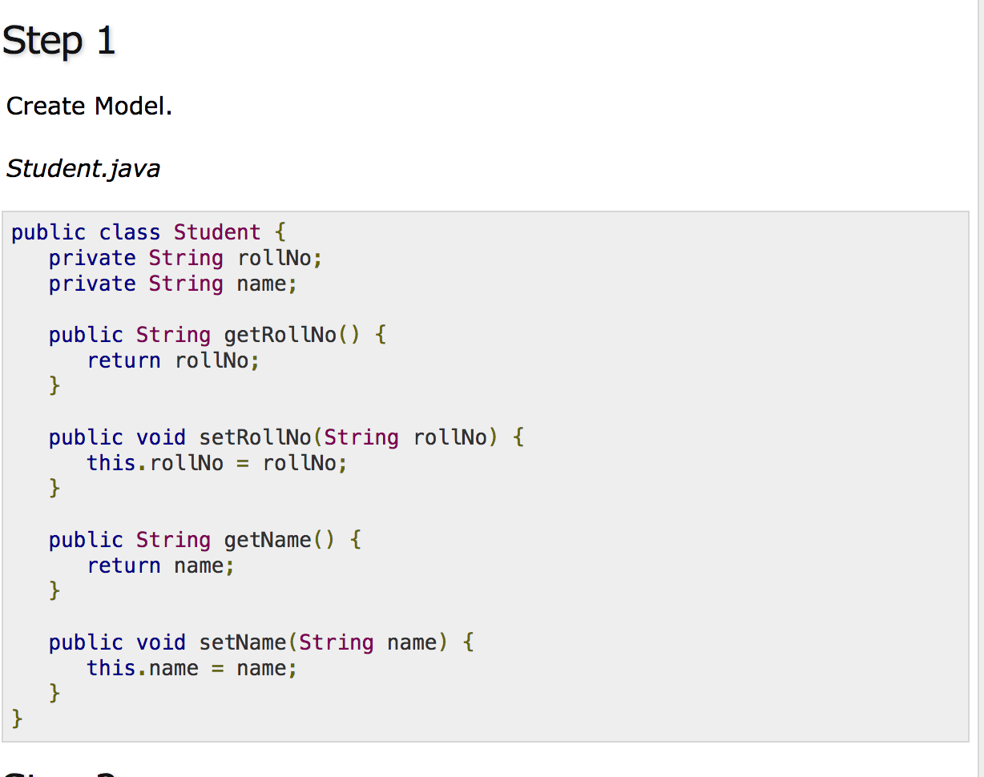

Slide 10
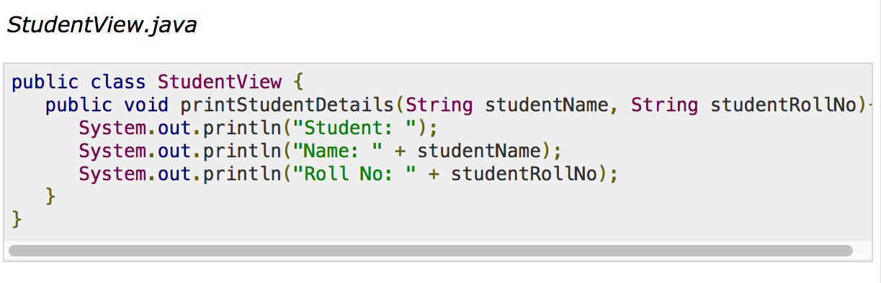

Slide 11
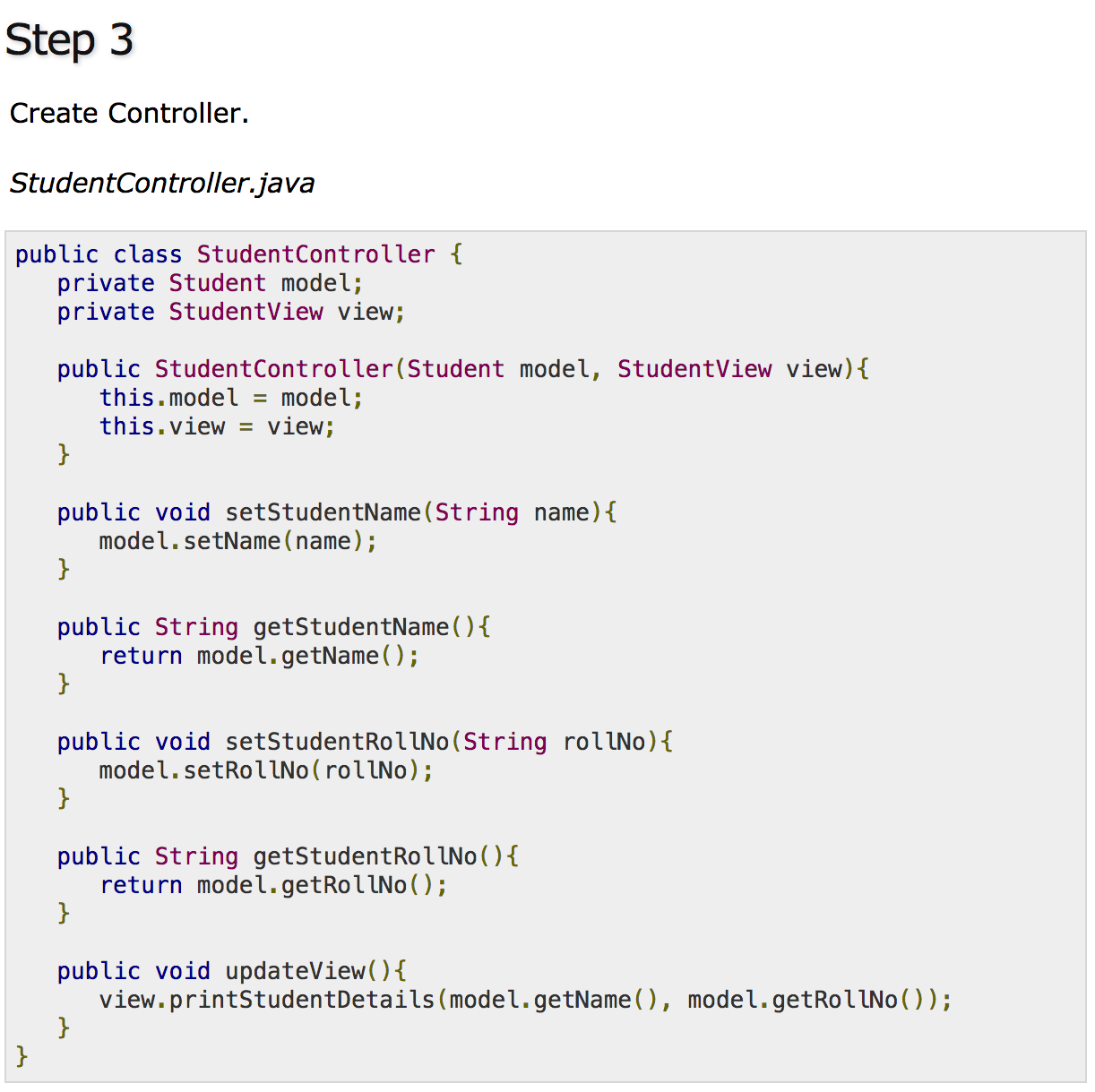

Slide 12
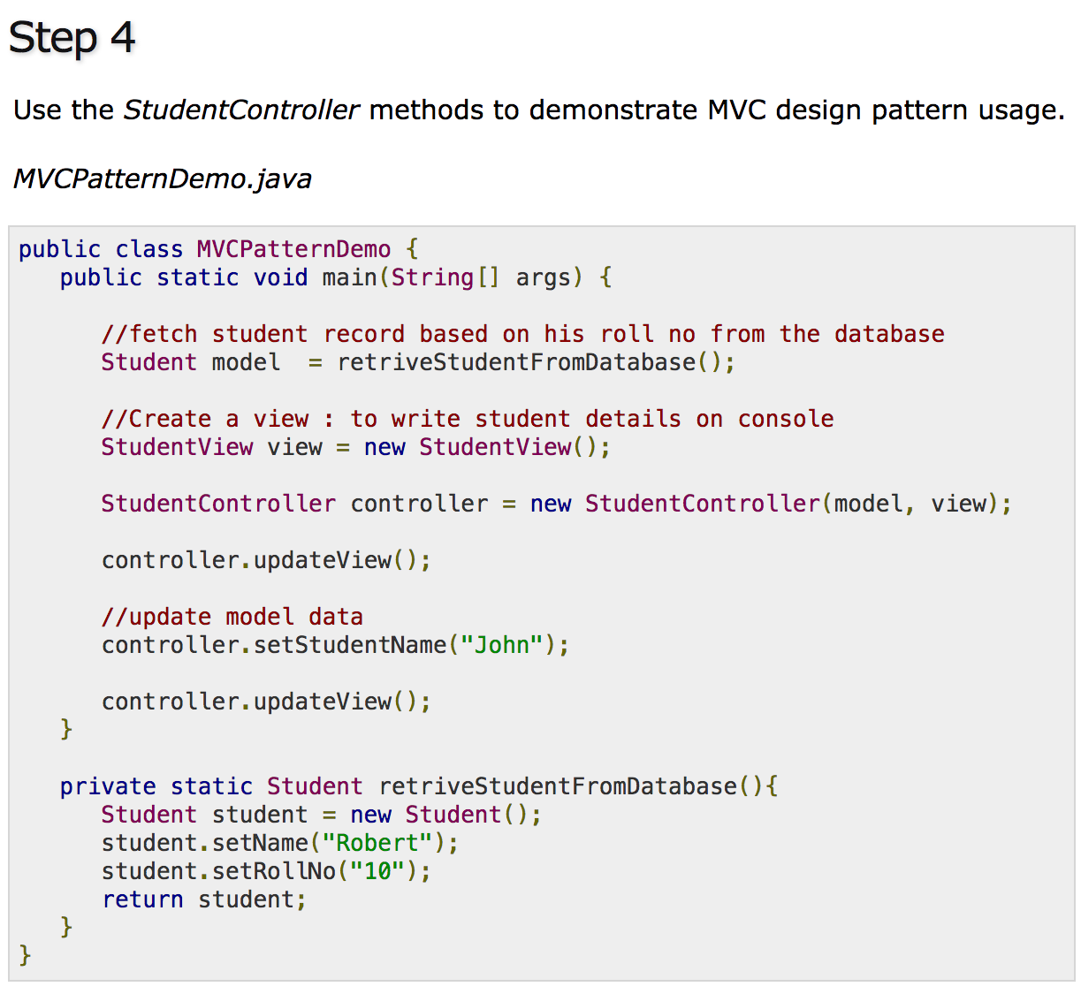

Slide 13
